Slide 1


Unlocking AWS Security: A Guided Tour through Common Misconfigurations
Sahil Phalle

Slide 2


Hello!
I’m Sahil Phalle 👋
Cybersecurity Analyst at Xbiztechventures
Expertise in: Web, API, Network & Cloud Security
Certifications: eJPT
Fun fact: Currently exploring advanced cloud security techniques!
Connect with Me
sahil_phalle_7
sahil-phalle

Slide 3
What We’ll Cover
1. Introduction to AWS and Cloud Security
2. Hacker Mindset for Cloud Attacks
3. AWS AMI Misconfigurations
4. Scenario 1: Exploring the AMI Catalog
5. AWS RDS Misconfigurations
6. Scenario 2: Identifying Public RDS Instances
7. Tools and Extra Resources
8. Q&A Session

Slide 4
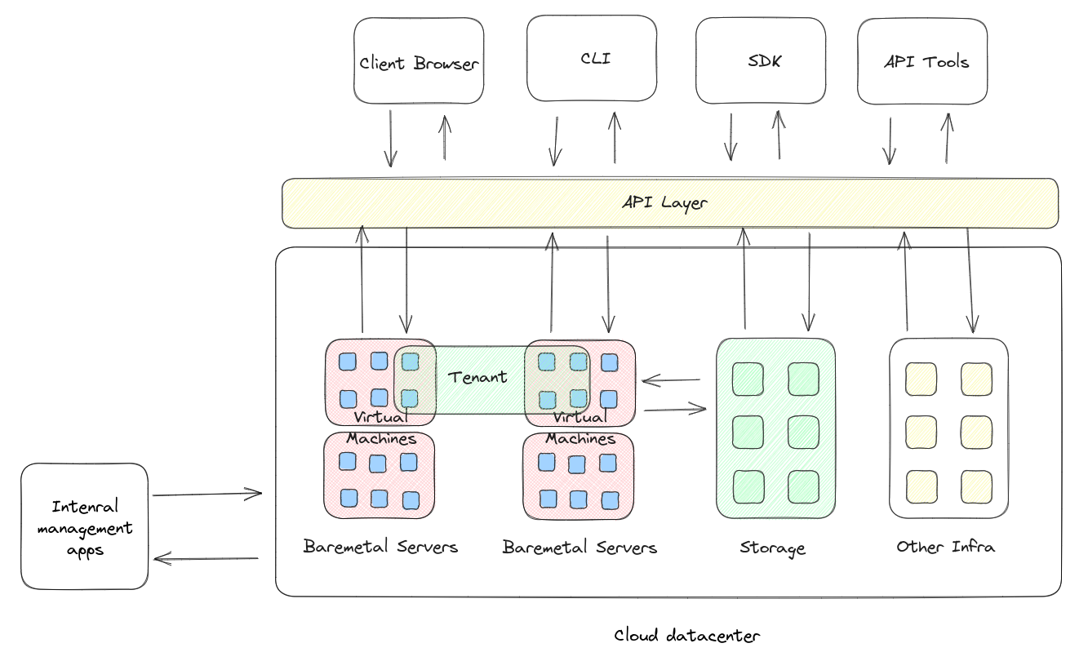
AWS in General

Slide 5
AWS and Cloud Security as a Whole
Security is the responsibility of both the cloud provider and the tenant owner
APIs serve as the main gateway for interacting with the cloud.
Cloud providers are vulnerable to all the risks associated with APIs.
Improper configurations that undermine Confidentiality, Integrity, and Availability are exploited, leading to data breaches.

Slide 6
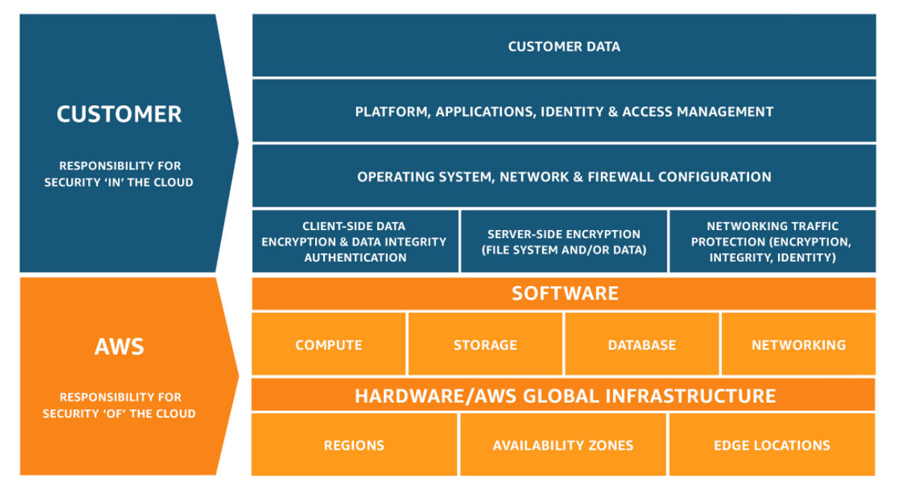
AWS Shared Responsibility Model
https://aws.amazon.com/compliance/shared-responsibility-model/

Slide 7
Hacker Mindset for attacking cloud
While identifying weaknesses in cloud providers is more challenging, discovering misconfigured tenant resources is far easier.
Everyone reuses stuff - users, roles, tokens, keys and even resources like VMs and storage
The service that you gain access to may be able to give additional access
Attached roles and permissions
Filesystem secrets
Environment variables
Network access through resource

Slide 8
AWS AMI
An AMI contains the software configuration (for example, an operating system, an application server, and applications) required for the creation of EC2 instances.
When you launch an instance, you must specify an AMI
AMIs are region specific
You create an AMI from an EC2 instance and EC2 instances from AMIs
An AMIs permissions can be updated to become public to all AWS users
There are thousands of AMIs in the AWS marketplace and lots more that are public
AWS has trusted vendors that you can create AMIs from, this is recommended so that you don’t accidentally use a backdoored AMI

Slide 9
AWS AMI
Scenario 1 - Explore the AMI Catalog

Slide 10
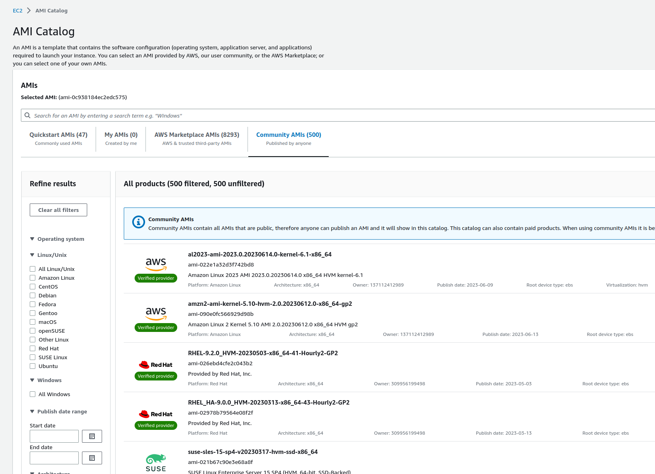
AMI
Catalog

Slide 11
AWS AMI
Scenario 1 - Create an EC2 instance from AMI

Slide 12

Now you’re probably thinking, ‘Alright, we get how to grab public AMIs, but is there a magic trick to automate finding the secrets?’ 😏

Slide 13
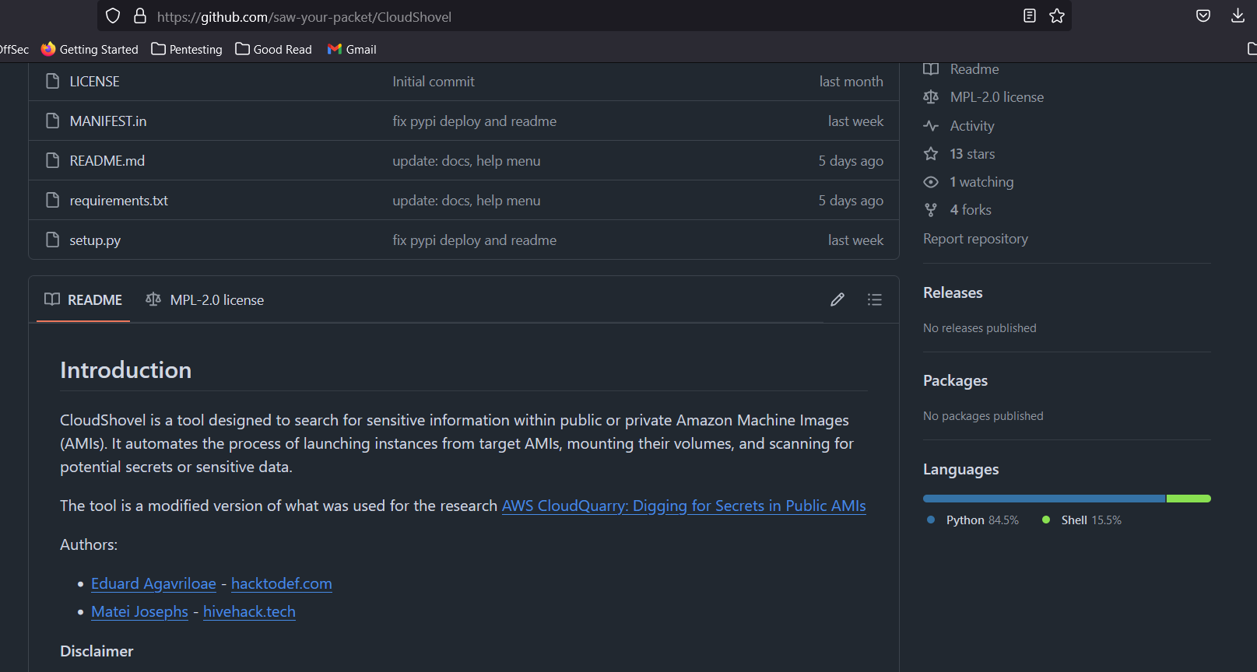
AWS AMI
CloudShovel
https://github.com/saw-your-packet/CloudShovel

Slide 14
AWS RDS( and Aurora)
Amazon Relational Database Service (Amazon RDS) is a web service that makes it easier to set up, operate, and scale a relational database in the cloud.
Amazon RDS
MySQL
MariaDB
PostgreSQL
Oracle
Microsoft SQL Server
Amazon Aurora is a fully managed relational database engine that's built for the cloud and compatible with MySQL and PostgreSQL. Amazon Aurora is part of Amazon RDS.

Slide 15
Scenario 1 - Public RDS Snapshot - Finding the Snapshot

Slide 16
Scenario 2 - Finding Public RDS Instances.

Slide 17
Finding Public RDS Instances
All RDS hostnames are DNS compliant
masterclass-acme-prod.cio3jjxaatse.us-east-1.rds.amazonaws.com
Some places you can find RDS instances (with credentials sometimes!!!)
Google search site:pastebin.com | site: gist.github.com “rds.amazonaws.com”
Shodan search for org:Amazon “rds.amazonaws.com”
Censys search
GitHub code search for “rds.amazonaws.com” pass

Slide 18
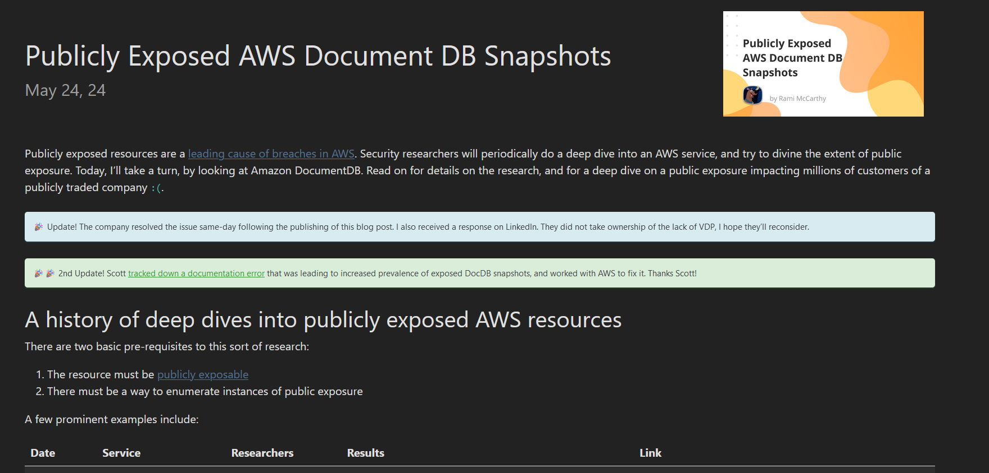
Extra Resources.
https://ramimac.me/exposed-docdb

Slide 19
Acknowledgments & References
https://kloudle.com/masterclass/
https://github.com/saw-your-packet/CloudShovel
https://www.mitiga.io/blog/how-mitiga-found-pii-in-exposed-amazon-rds-snapshots
https://ramimac.me/exposed-docdb

Slide 20

Questions?
Or are you all cloud security experts now?

Slide 21
THANK YOU
Connect with Me
sahil_phalle_7
sahil-phalle

